Slide 1
Significant Figure

Slide 2
What are significant digits?
The significant digits in a measurement consist of all the digits known with certainty plus one final digit, which is uncertain or is estimated.

Slide 3
RULE: If a number contains no zeros, all of the digits are significant.
Answers:
3
4
2
3
How many significant digits are in each of the following examples?
a) 438
b) 26.42
c) 1.7
d) .653

Slide 4
RULE: All zeros between two non zero digits are significant.
How many significant digits are in each of the following examples?
a) 506
b) 10,052
c) 900.431
Answers:
3
5
6

Slide 5
RULE: Zeros to the right of a non zero digit a) If they are to the right of a nonzero number but not sandwiched between nonzero and decimal point, they are not significant.
How many significant digits are in each of the following examples?
a) 4830
b) 60
c) 4,000
Answers:
3
1
1

Slide 6
RULE: Zeros to the right of a non zero digit b) If these zeros are sandwiched between a nonzero number and a decimal point, they are significant.
How many significant digits are in each of the following examples?
a) 4830.
b) 60.
c) 4,000.
Answers:
4
2
4

Slide 7
RULE: All zeros to the left are not significant.
How many significant digits are in each of the following examples?
a) 0.06
b) 0.0047
c) 0.005
Answers:
1
2
1

Slide 8
RULE: All zeros to the right of a decimal point are significant (not at the left)
How many significant digits are in each of the following examples?
a) .870
b) 8.0
c) 16.40
d) 35.000
e) 1.60
Answers:
3
2
4
5
3

Slide 9
Upper & Lower Bounds

Slide 10
Upper & Lower Bounds
Examples:
Find the upper and lower bounds for each quantity
Eg1
The population of Liverpool is 466,000 (to the nearest 1000)
Lower Bound:
465,500
Upper Bound:
466,499
Eg2
The distance from L’pool to M’chester is 34 miles (nearest mile)
Lower Bound:
33.5 miles
Upper Bound:
34.5 miles
Eg2
0.035m (to 2sf)
Lower Bound:
0.0345m
Upper Bound:
0.0355m

Slide 11
Upper & Lower Bounds
Exercise 1:
Find the upper and lower bounds for each quantity
1
4500 people (nearest 100)
LB: 4450 UB: 4549
2
163cm (nearest cm)
LB: 162.5 UB: 163.5
3
£9 (1sf)
LB: £8.50 UB: £9.49
4
1.1kg (2sf)
LB: 162.5 UB: 163.5
5
A box of 8300 sweets (3sf)
LB: 8295 UB: 8304
6
2000cm (nearest 100)
LB: 1950 UB: 2050
7
James is putting a table into a space which is 1450mm wide (nearest mm). The cupboard is 145cm wide. Why might the cupboard not fit?

Slide 12
Upper & Lower Bounds
Calculations:
Find the upper and lower bounds for the area of this triangle.
4cm
6cm:
LB = 5.5cm
UB = 6.5cm
6cm
4cm:
LB = 3.5cm
UB = 4.5cm
Upper bound Area:
½ x 6.5 x 4.5 =
14.625cm²
Lower bound Area:
½ x 5.5 x 3.5 =
9.625cm²

Slide 13
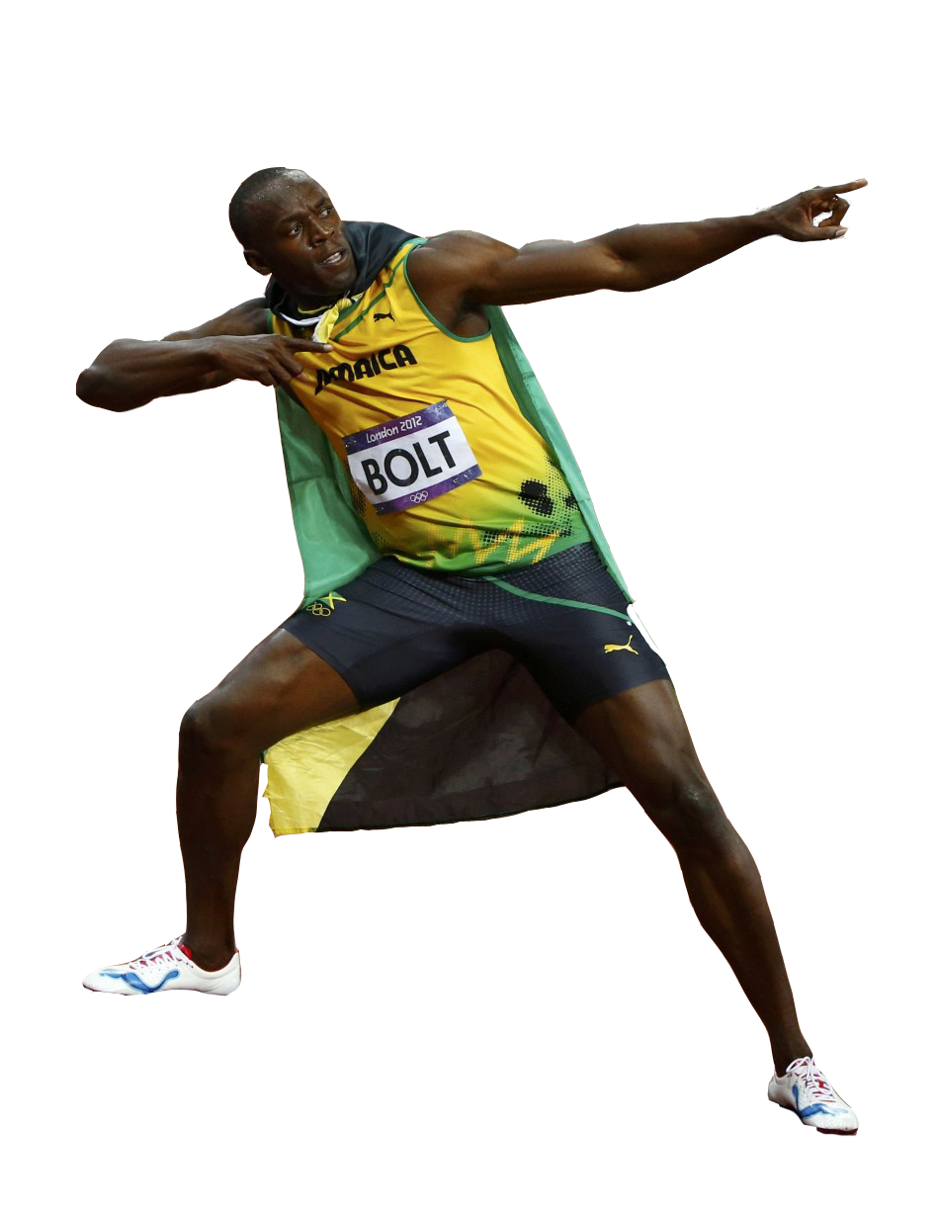
Upper & Lower Bounds
Calculations:
Find the upper and lower bounds for the speed of Usain Bolt’s fastest 100m (to nearest m) race of 9.58 seconds (to nearest 2 dp)
100m:
LB = 99.5m
UB = 100.5m
9.58 secs:
LB = 9.575 secs
UB = 9.585 secs

Slide 14
Upper & Lower Bounds
Examples:
Find the upper and lower bounds for each quantity
Eg4
8.8 (1dp) x 6 (whole number)
Lower Bound:
8.75 x 5.5
Upper Bound:
8.85 x 6.5
= 48.125
= 57.525
Eg5
All to 2sf
LB:
UB:

Slide 15
Speed Distance Time

Slide 24
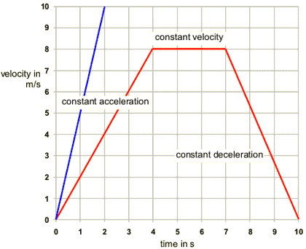
Velocity-Time Graphs
Velocity on y-axis
Time on x-axis

Slide 25
Velocity- Time Graphs

Slide 26
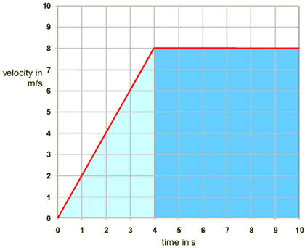
Velocity-Time Graphs
Displacement is the area under the curve.
Slope is acceleration.
Instantaneous Velocity is any point on the line.

Slide 28
Number Groups

Slide 30
The real numbers includes both the rational and irrational numbers.
The irrational numbers are all numbers which when written in decimal form does not repeat and does not terminate.
The rational numbers are numbers which can be expressed as ratio of integers. That means, if we can write a given number as a fraction where the numerator and denominator are both integers; then it is a rational number.

Slide 32
The integers include all whole numbers together with the “opposites” of the natural numbers (their negatives).… -4, -3, -2, -1, 0, 1, 2, 3, 4 …

Slide 34
Think of whole numbers as natural numbers and the number zero.0, 1, 2, 3, 4…

Slide 36
Number Symbols
Natural Numbers (N)
Whole Numbers (W)
Integers (Z)
Rational numbers (Q)
Real numbers (R)

Slide 37
Arithmetic Sequence

Slide 38
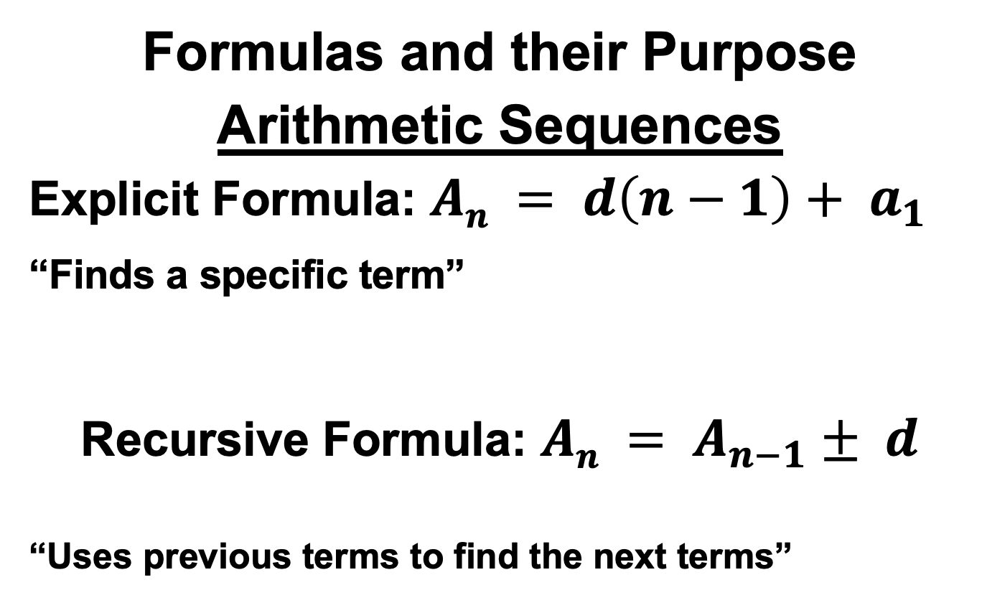
Formulas and their Purpose
Arithmetic Sequences
Explicit Formula: $An = d\left(n−1\right)+ a_{1}$
_{“Finds a specific term”}
Recursive Formula: $An = A_{n−1}± d$
“Uses previous terms to find the next terms”
First Term
Common Difference
Current Term
Previous Term

Slide 39
Guided Practice
Example 1
Consider the sequence 3, 6, 9, 12, 15, 18, …
Find the following terms:
$$a_{2}=____$$
$$5th Term=_____$$
$$a_{8}=____$$

Slide 40
Exponent Rules

Slide 41
Exponents
exponent
Power
base
5³ means 3 factors of 5 or 5 x 5 x 5

Slide 42
The Laws of Exponents:
#1: Exponential form: The exponent of a power indicates
how many times the base multiplies itself.
n factors of x

Slide 43
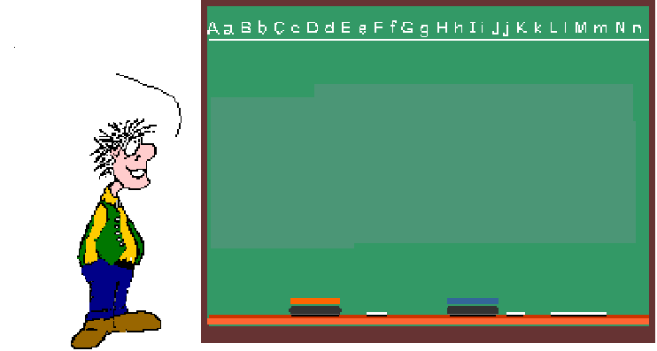
#2: Multiplying Powers: If you are multiplying Powers with the same base, KEEP the BASE & ADD the EXPONENTS!
So, I get it! When you multiply Powers, you add the exponents!

Slide 44
#3: Dividing Powers: When dividing Powers with the same base, KEEP the BASE & SUBTRACT the EXPONENTS!
So, I get it!
When you divide Powers, you subtract the exponents!

